Slide 1
PyQt5 Library
INTERFACE
Attribute:
GameCore: Attribute Connect to class “minesweeper”
Clock: QTimer & QLCD_Number
Interface
Function:
InterfaceUpdate: Update the Interface
TimingUpdate: Update time
UpdateNumber
Redo:
Undo:
Et, al:
QtCore
QtGUI
QtWidgets
QTimer
QMainWindow
QPixmap
QLCD_Number
QFont
QPushButton
QIcon
QFont
CustomButton
Module: Sys, cProfile, time
PREPROCESSING.PY
Python Decorator Functions
STORAGE
CORE.PY
Game Logic: Class “minesweeper”
Attribute:
__coreMatrix: Hidden Matrix for Searching
InterfaceMatrix: Representation of Interface
__Stack(s): Redo – Undo Stack
Notation: Get from Config.py
Function:
Build: Initialize
Check: Hidden Check for Validity
Display: Display on Console (for Debug)
DepthFirstFlow: Inherited from Depth First Search (O(N)), used for clicking empty cell
Redo, Undo:
Update: Update Interface Matrix
CONFIG.PY
Used to get directory or size of image in storage
Function + Python Directory (Hashtable)
Attribute:
WindowSize – (Project) Directory – (Core) NOTATION
Function:
getBombNumberImageProperty
getBombPositionForDisplay
getFlagImage, getBombImage
getGameBackground, getGameKey
getGameTitle, getOpenInterface, getEndInterface
getMouseInstruction()
Library: Numpy, Memory_profiler

Slide 2
PyQt5 Library
INTERFACE
Attribute:
GameCore: Attribute Connect to class “minesweeper”
Clock: QTimer & QLCD_Number
Interface
Function:
InterfaceUpdate: Update the Interface
TimingUpdate: Update time
UpdateNumber
Redo:
Undo:
Et, al:
QtCore
QtGUI
QtWidgets
QTimer
QMainWindow
QPixmap
QLCD_Number
QFont
QPushButton
QIcon
QFont
CustomButton
Module: Sys, cProfile, time
PREPROCESSING.PY
Python Decorator Functions
STORAGE
CORE.PY
Game Logic: Class “minesweeper”
Attribute:
__coreMatrix: Hidden Matrix for Searching
InterfaceMatrix: Representation of Interface
__Stack(s): Redo – Undo Stack
Notation: Get from Config.py
Function:
Build: Initialize
Check: Hidden Check for Validity
Display: Display on Console (for Debug)
DepthFirstFlow: Inherited from Depth First Search (O(N)), used for clicking empty cell
Redo, Undo:
Update: Update Interface Matrix
CONFIG.PY
Used to get directory or size of image in storage
Function + Python Directory (Hashtable)
Attribute:
WindowSize – (Project) Directory – (Core) NOTATION
Function:
getBombNumberImageProperty
getBombPositionForDisplay
getFlagImage, getBombImage
getGameBackground, getGameKey
getGameTitle, getOpenInterface, getEndInterface
getMouseInstruction()
Library: Numpy, Memory_profiler

Slide 3
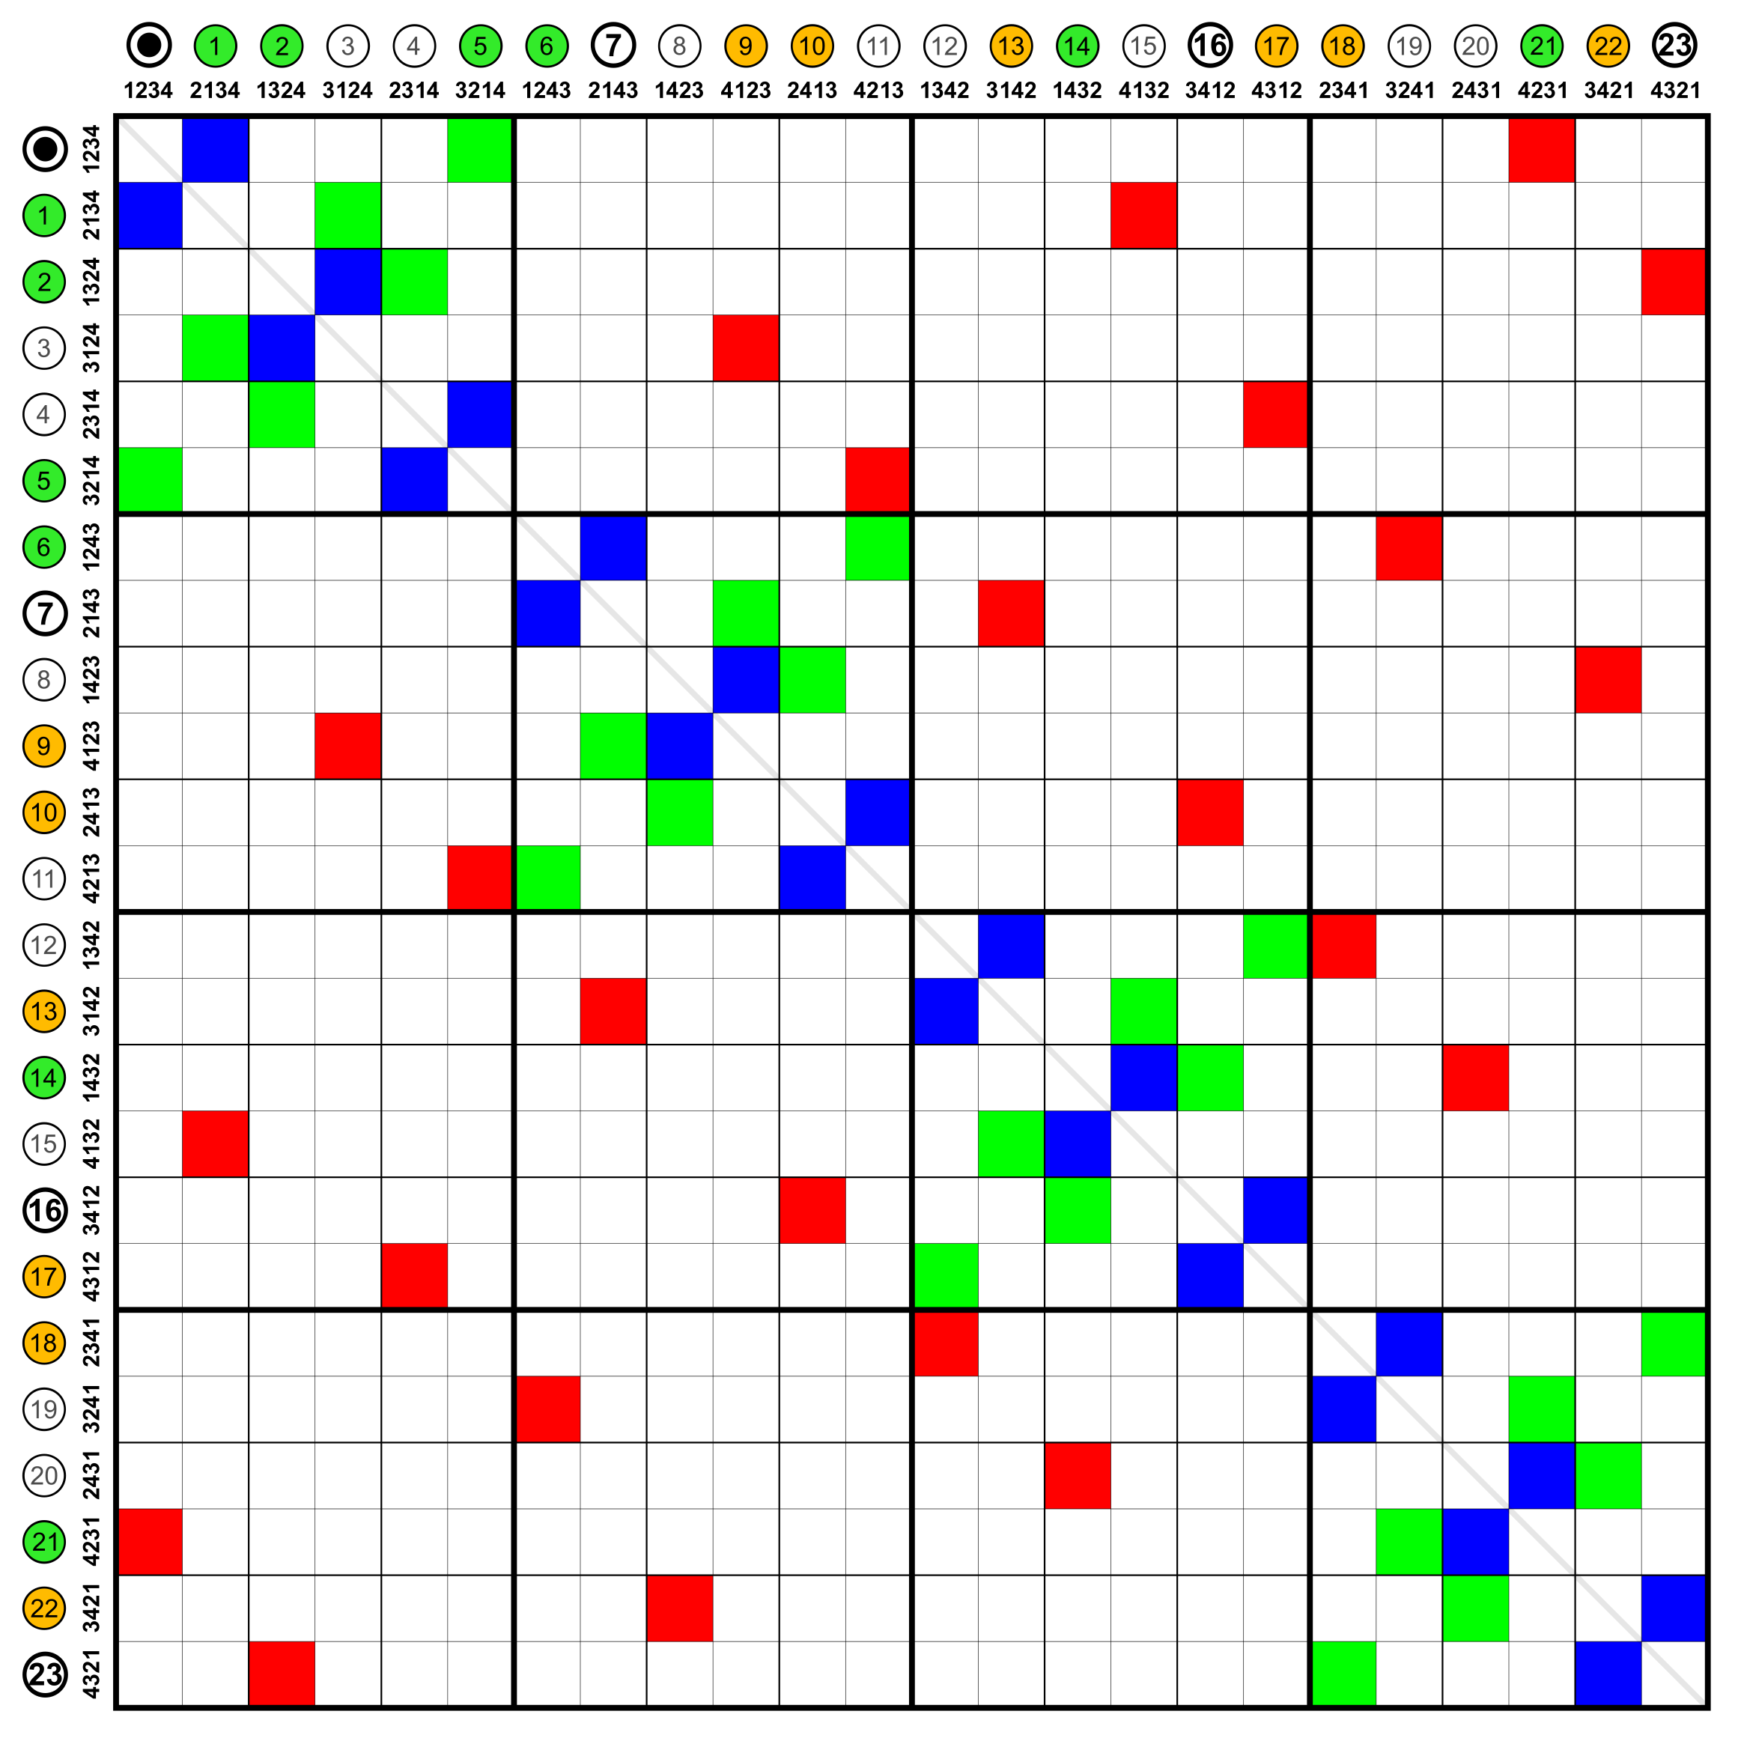
Minesweeper (CORE.PY)
Interface (INTERFACE.PY)
Interface Matrix (Numeric)
User’s State
Interface Matrix (Object)
Node’s Representation

